Slide 1


Software Design & System Design
Design Patterns
Otávio Santana, Founder
otavio@os.expert

Slide 2
Introduction
Topics on this class
Singleton
Factory
Strategy
Observer
Builder
Prototype
Adapter
Decorator
Proxy

Slide 3
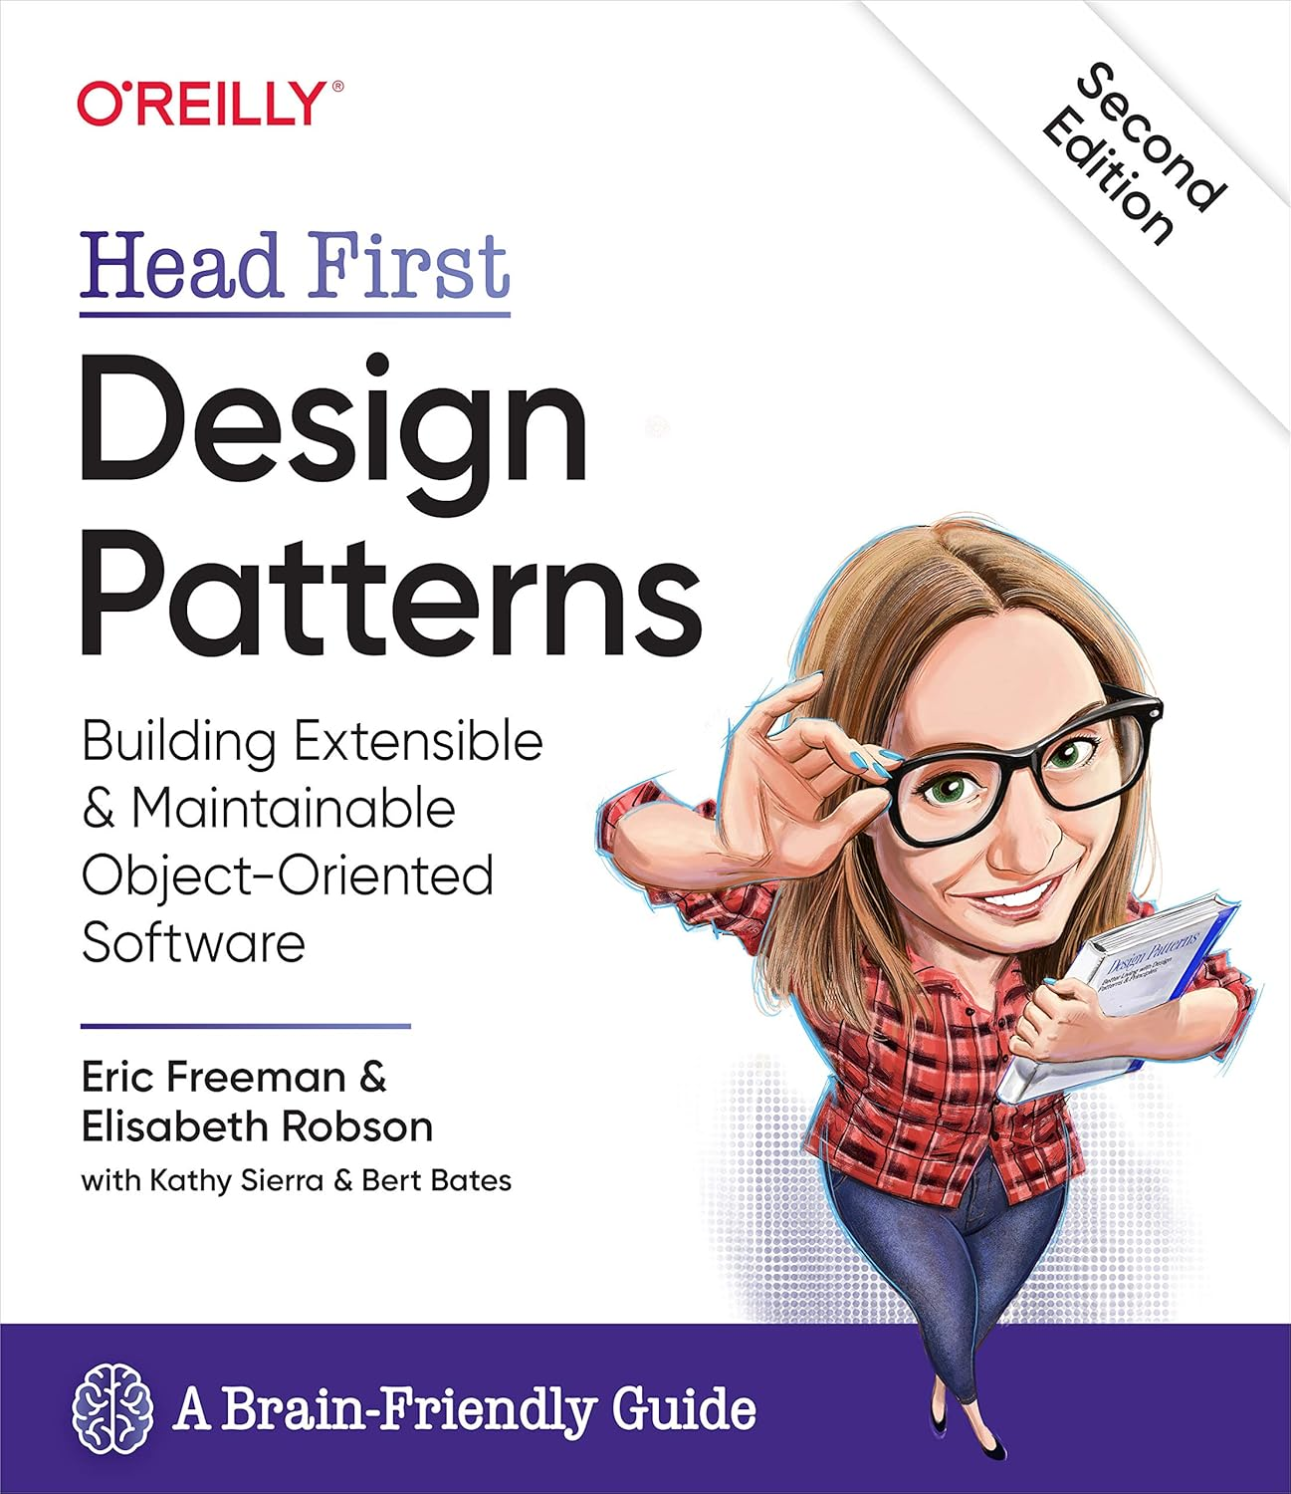
OO Design Principles (Head First)
Nine Rules That Shape Smart Patterns
Encapsulate What Varies
Favor Composition Over Inheritance
Program to Interfaces, Not Implementations
Strive for Loosely Coupled Designs
Remember the Open/Closed Principle
Depend Upon Abstractions, Not Concretions
Only Talk to Your Friends (Law of Demeter)
Don’t Call Us, We’ll Call You (Inversion of Control)
Encapsulate Invocation

Slide 4
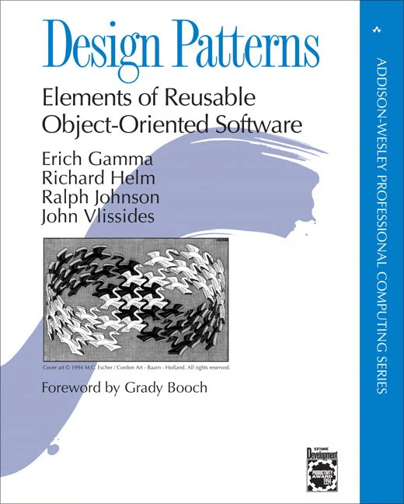
The Gang of Four (GoF) Design Patterns
The Original 23 Patterns That Changed Software Design
“Design Patterns: Elements of Reusable Object-Oriented Software” by Erich Gamma, Richard Helm, Ralph Johnson, and John Vlissides

Slide 5
The Gang of Four (GoF) Design Patterns
The Original 23 Patterns That Changed Software Design
🔧 Creational Patterns (5)
Concerned with the way objects are created
Singleton
Factory Method
Abstract Factory
Builder
Prototype
🏗 Structural Patterns (7)
Focus on object composition and how classes work together
Adapter
Bridge
Composite
Decorator
Facade
Flyweight
Proxy

Slide 6

The Gang of Four (GoF) Design Patterns
The Original 23 Patterns That Changed Software Design
🔁 Behavioral Patterns (11)
Deal with object interaction and responsibility
Chain of Responsibility
Command
Interpreter
Iterator
Mediator
Memento
Observer
State
Strategy
Template Method
Visitor

Slide 7

Singleton Pattern
One Instance to Rule Them All?
Ensures a class has only one instance and provides a global point of access to it.
❗ But... Is Singleton an Anti-Pattern?
Does it break testability?
Does it hide dependencies?
Does it lead to global state?

Slide 8
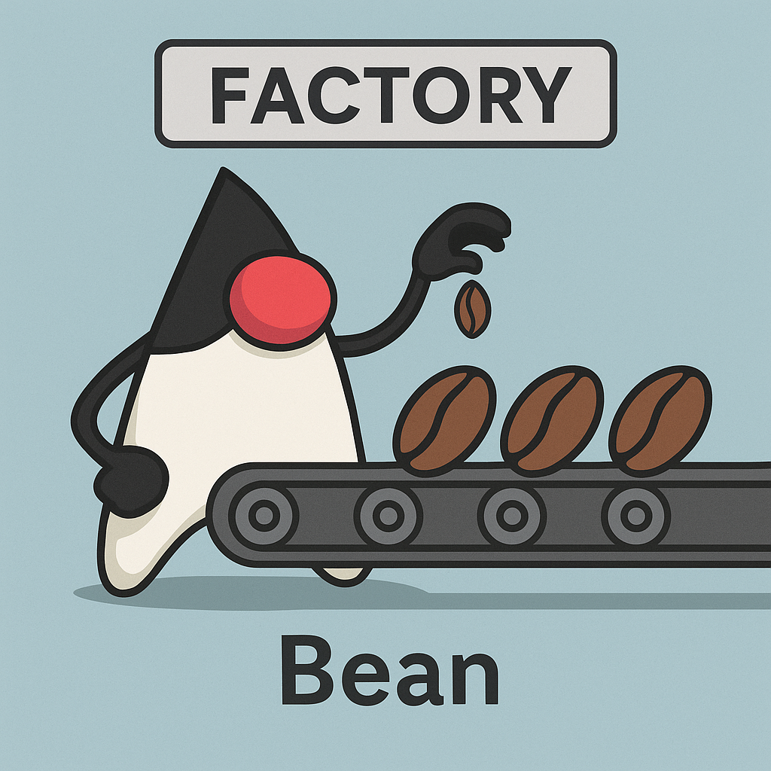
Factory Pattern
Creating Objects Without Exposing Instantiation Logic
A creational pattern that delegates the responsibility of object creation to a factory method or class
✅ Benefits
Decouples instantiation from logic
Adheres to Open/Closed Principle
Enables polymorphism at creation time

Slide 9
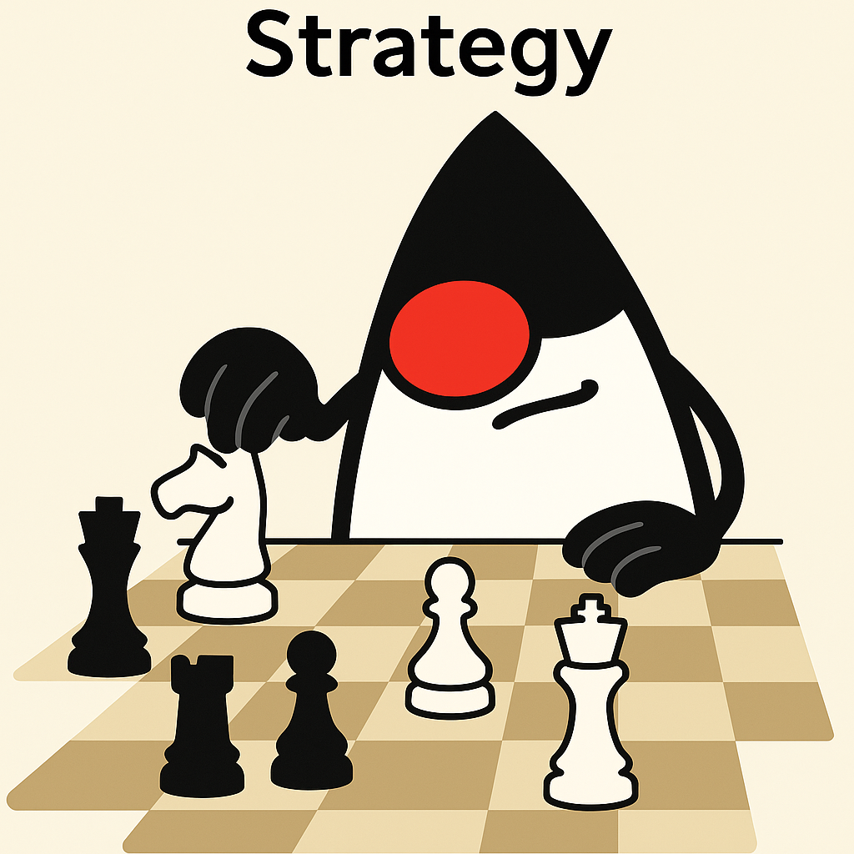
Strategy Pattern
Varying Behavior at Runtime Without Ifs
You need to switch behavior dynamically
You want to avoid long if-else or switch statements
You want to follow Open/Closed Principle for behaviors

Slide 10

Observer Pattern
Reacting to Changes Without Tight Coupling
You need to notify multiple components of a change
You want to decouple publisher from subscribers
Used in event-driven and GUI systems, or to build reactive APIs

Slide 11

Builder Pattern
Constructing Complex Objects Step by Step
The object requires many parameters (especially optional ones)
You want to avoid telescoping constructors
You need to ensure immutability while simplifying object creation

Slide 12
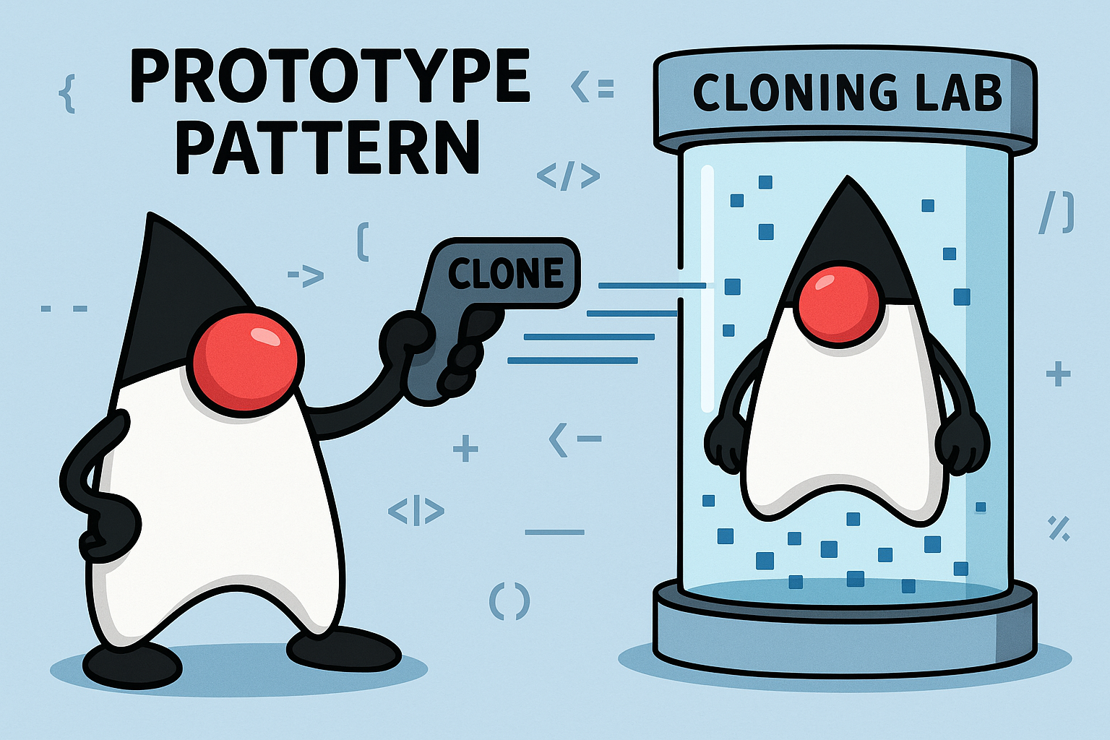
Prototype Pattern
Cloning Objects Instead of Rebuilding Them
Object creation is expensive or slow
You need to clone objects with complex initialization
You want to keep instantiation decoupled from the client code

Slide 13

Adapter Pattern
Making Incompatible Interfaces Work Together
You need to integrate third-party or legacy classes
You want to decouple the client from specific implementations
You need to adapt incompatible APIs in a clean, maintainable way

Slide 14
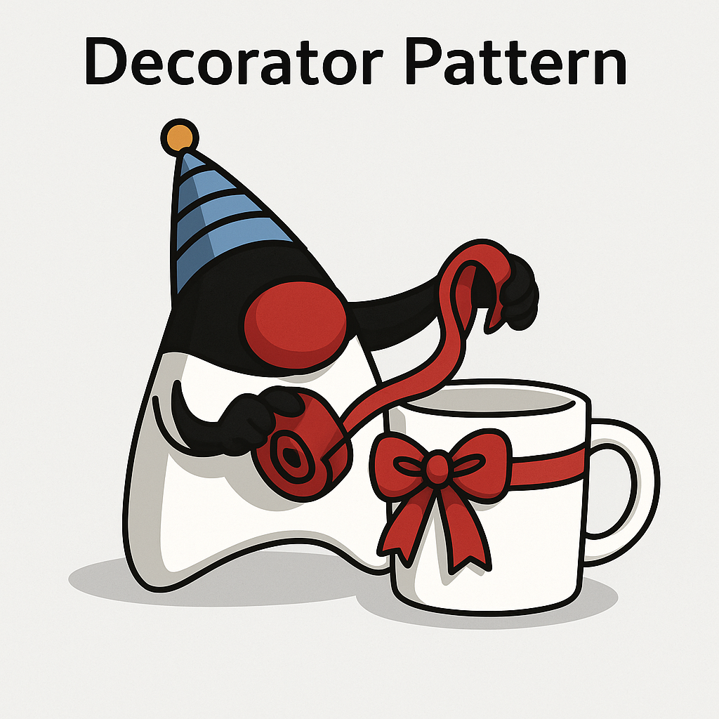
Decorator Pattern
Add Behavior Without Modifying Code
You need to add responsibilities to objects without changing their code
You want to use composition over inheritance
You want flexible layering of features (e.g., logging, validation, formatting)

Slide 15

Proxy Pattern
Controlling Access with a Representative
You need to add access control, lazy loading, or caching
You want to log, secure, or monitor access without touching the real object
You’re working with remote or expensive-to-create objects

